Slide 1
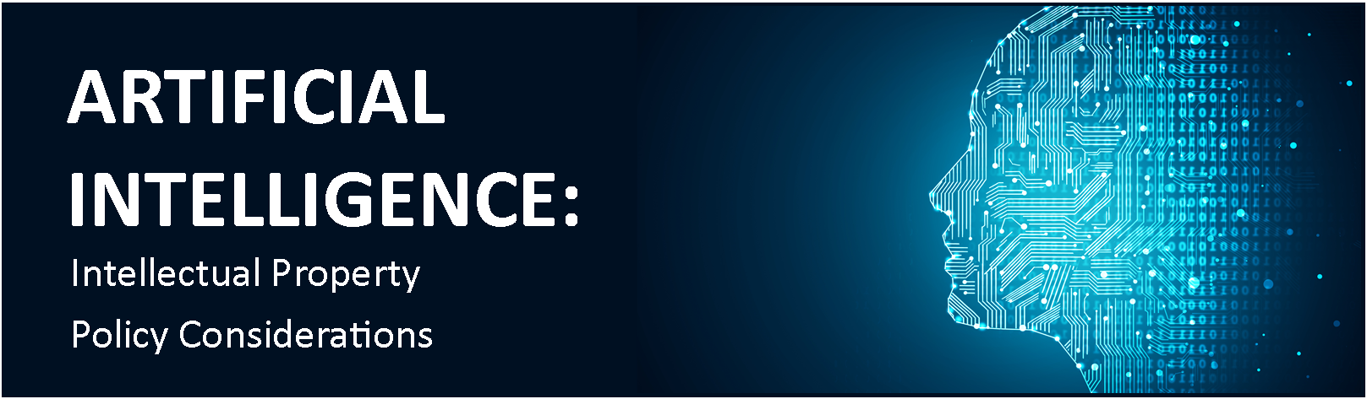
Artificial Intelligence: Intellectual Property Policy Considerations – U.S. Patent and Trademark Office, Jan. 31, 2019
Summary and comments by Andy N. Kim

Slide 2
Outline
Overview of AI Policy in US
Patenting AI
Global Perspectives

Slide 3
Overview of AI Policy in US (Dr. Lynne Parker - Assistant Director for AI at White House Office of Science and Technology Policy)
High Priority in AI R&D: President Trump signed an executive order creating a program called the American AI Initiative - Pentagon (Sept. 2018) announced more than $2 billion spending over the next five years to advance the foundations of AI technology
Removing barriers (traffic rules, navigation rules for AI driven cars and AI operated Drones, AI diagnosing disease)
Sharing of data and research on AI
Addressing AI-work force: rapid retraining of workers
Leveraging AI for national defense/security and government services: using AI in US PTO, FDA, and FBI.
US leading international AI negotiations for international cooperation and competitiveness in G7 and OECD countries.

Slide 4
Patenting AI (panel discussions)
Class 706 (Data Processing – AI): pre-Alice level of allowance up until Electric Power Group, LLC v. Alstom S.A. (Fed. Cir. 2016) "a process of gathering and analyzing information of a specified content, then displaying the results“
What is AI?
Machine
Learning
inputs
output

Slide 5
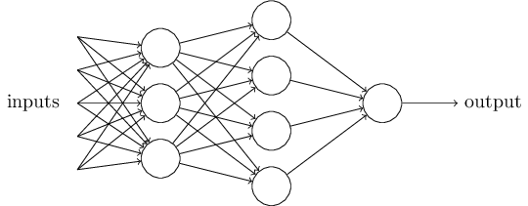
What is AI?
0
0
0
0
0
0
0
0
0
0
0
0
0
0
0
0
0
0
0
0
0
0
0
0
1
-2
2
2
1
-2
1
-1
-1
1
-1
1
3
2
3
-2
2
3
3
2
1
2
-1
1

Slide 6
Patenting AI (panel discussions)
What parts of the technology are being claimed as the invention? (processes by which the system is created by training, or final product after the processes)
Dig-deep: full detailed disclosures of inventors for AI applications
  Specific details of training data or how that data is processed,
  Specific data structures implementing an AI/ML system (e.g. a neural network),
  Specific heuristics used for training feedback,
  Specific H/W (e.g. sensors, remote devices, etc.), and
  Technical improvements to functions of a computer.
Demonstrate it can’t be done “in the human mind” or goes beyond “ordinary mental activity” (goal of AI is often replicate human activity or tasks previously performed by human)

Slide 7
Global Perspectives: EPO, CN, SG, JP
Raising the bar for patentability in the European Union:
According to Nov. 2018 new EPO guidelines, artificial intelligence (“AI”) and machine learning (“ML”) inventions as largely unpatentable.
AI and ML are “based on computational models and algorithms for classification, ….” and thus directed to a mathematical method excluded from patentability.

Slide 8
Global Perspectives: EPO, CN, SG, JP
Two steps approach: (1) does the mathematical method have a technical character? (e.g., computer implemented method) (2) does the mathematical method make a technical contribution to inventive step (e.g., applied to a specific technical problem)?
“field of application” will be an important component in determining whether the mathematical method makes a technical contribution to inventive step and is therefore patentable.
whether the mathematical method makes a technical contribution to inventive step is assessed under two criteria: (1) the mathematical method’s is applied to a field of technology,” and/or (2) is adapted to “a specific technical implementation”.

Slide 9
Global Perspectives: EPO, CN, SG, JP
Examples of patentable applications of mathematical methods to a “field of technology”:
generating random numbers according to a specific distribution for numerical simulation of a circuit subject to a noise.
a neural network in a heart-monitoring apparatus for identifying irregular heartbeats.

Slide 10
Global Perspectives: EPO, CN, SG, JP
Examples of unpatentable applications of mathematical methods to a “field of technology”:
classifying text documents solely in respect of their textual content is a linguistic one.
classifying data records without any indication of a technical use being made of the resulting classification.

Slide 11
Global Perspectives: EPO, CN, SG, JP
Year 2018, Chinese government (Dr. Qian Wang, a professor of Law at the East China Univ. of Political Science)
announced a set of initiatives to be a global leader in AI by 2030.
Baidu has invested approximately $1.5 billion in AI related R&D, and other major tech players like Alibaba and Tencent have created AI dedicated labs.
Implement innovation friendly policies (higher priority for AI patent application to fast track – 3 months to get patented!)

Slide 12
Global Perspectives: EPO, CN, SG, JP
Singapore’s AI initiative 2018 (Dr. Daryl Lim at the John Marshall Law school)
National policy based on SG’s flexibility and understanding of the potential of AI - no §101 issue in SG
National initiative aims to “bring… together related agencies to develop deep AI capabilities” and invest up to $150 million in AI over the next five years.
Equipping the industry workforce with specialized skill sets in AI, data science and analytics.

Slide 13
Global Perspectives: EPO, CN, SG, JP
Japan’s AI-related IP strategy (Matsuo Nonaka, Senior Director at the JP PO)
Focuses on (i) acquisition and management of AI related data, (ii) promotion and protection of AI applications, and (iii) protection of AI-generated works and inventions.
Japan has revised the Copyright Act and the Unfair Competition Prevention Act, published contract guidance on the utilization of AI and data, and is committed to continuing the discussion as AI evolves.

